Slide 1
IBM Advanced Data Science Capstone Project COVID-19 Predictions - by Sree

Slide 2
COVID-19 :
The 2019–20 coronavirus pandemic is an ongoing pandemic of coronavirus disease 2019 (COVID-19) caused by severe acute respiratory syndrome coronavirus 2 (SARS-CoV-2). The outbreak was identified in Wuhan, China, in Dec 2019.
The WHO declared the outbreak to be a Public Health Emergency of International Concern on 30 Jan 2020, and recognised it as a pandemic on 11 Mar 2020.
As of 20 Apr 2020, more than 2.4 million cases of COVID-19 have been reported in 185 countries and territories, resulting in more than 165,000 deaths. More than 623,000 people have recovered, although there may be a possibility of relapse or reinfection.
'CO' stands for 'corona‘, 'VI' for 'virus’ and 'D' for disease
Notes:
Current Coronoavirus pandemic is a Public health Emergency of International Concern. Its caused by Virus SARS-Cov-2.
outbreak originated in Wuhan, China in Dec 2019 and has led to 2.4 million cases since.

Slide 3
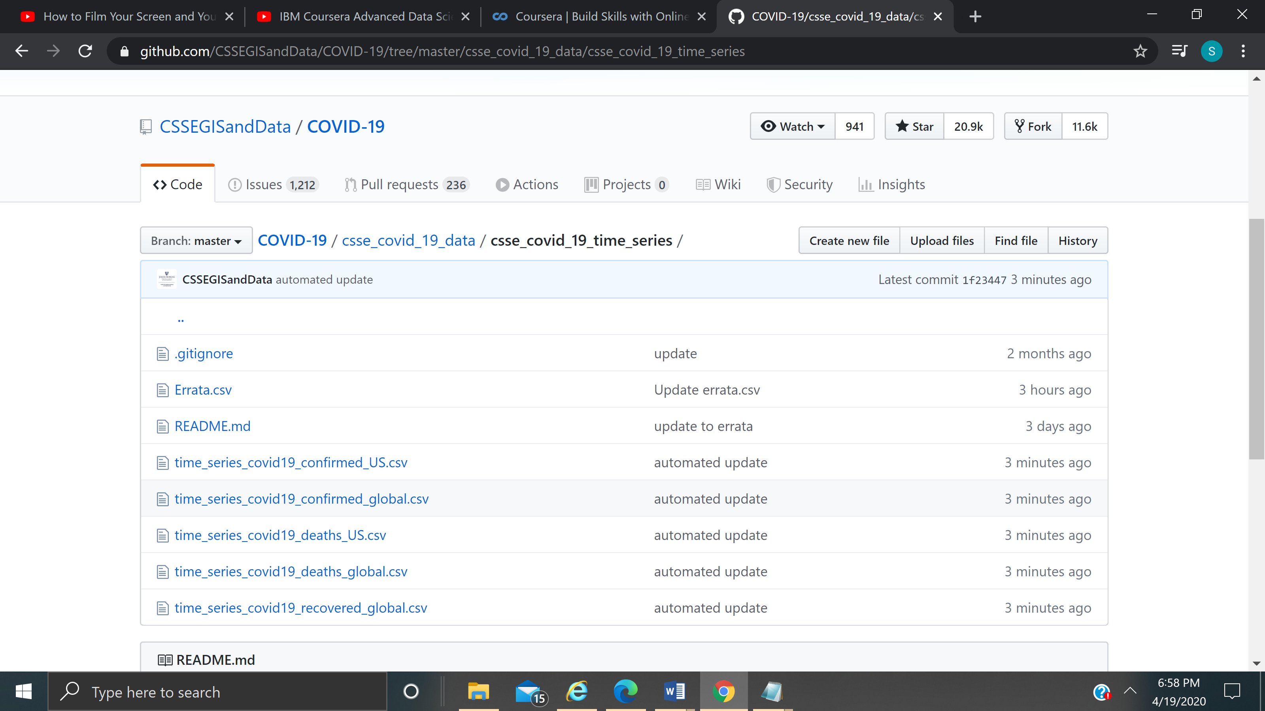
COVID-19 Predictions : data set
For this Project I’m referring to Kaggle Competition Site and using John Hopkins University DataSet from Github.

Slide 4
COVID-19 Predictions : Use Case
Predicting the Coronavirus COVID-19 confirmed cases for World and US by using Sequential Model. Show visualizations with Table data and various Graphs
Solution to the use case : My Solution is presented in PowerPoint in the next few slides and it is in notebook.

Slide 5
COVID-19 Predictions
Architectural choices :
Data Source : JHU CSSE Repository CSV files
Data Integration : Jupyter notebook
Data Repository : IBM Watson Studio
Analytics & Exploration : Jupyter notebook
Actionable Insights : Jupyter notebook
Applications / Data Products : PowerPoint Presentation, Jupyter notebook

Slide 6
Data Quality Assesment
Poor data quality is hindering organizations from performing to their full potential. This is where machine learning assumes its crucial role.
Missing values
Uniqueness
The actual data transformations are implemented in the Feature Creation asset deliverable; therefore, Data Cleansing is part of the Feature Creation task in this process model.

Slide 7
COVID-19 Predictions : Data Preprocessing & Feature Engineering
Model performance depends highly on how well data preprocessing has been carried out.
If features provided in the Model contains most of the information required to perform Supervised or UnSupervised Learning , Model will perform much better.
Feature Creation and Feature Engineering is one of the most important tasks in machine learning since it hugely impacts model performance.
Feature Transformation : Imputing Some algorithms are very sensitive to missing values, so filling of empty fields based on its value distribution
Notes:
data gets transformed, or Encoded, to bring it to such a state that now the machine can easily parse it. In other words, the features of the data can now be easily interpreted by the algorithm.

Slide 8
COVID-19 Predictions : Conti..
Feature Aggregation
Feature Creation : Aggregate-on-Target : Aggregating data at the Country/State level to put the data in a better perspective
Feature Importance has been plotted. Feature Selection was carried out based on Feature Importance plot.
This results in reduction of memory consumption and processing time
Train test split
Graphs in this Project
Displays the data by number of Cases per Days.
Displays the confirmed cases by top 10 Countries, States
Notes:
Aggregations provide us with a high-level view of the data as the behavior of groups or aggregates is more stable than individual data objects
TTS to evaluate Model Performance on unseen test data set.

Slide 9
COVID-19 Predictions
c) Model performance indicators :
MAE (Mean Absolute Error) : is the average of the difference between the Original Values and the Predicted Values. It gives us the measure of how far the predictions were from the actual output.
MSE (Mean Squared Error) : takes the average of the square of the difference between the original values and the predicted values. The advantage of MSE being that it is easier to compute the gradient
d) Model algorithm : I used Sequential Model algorithms for COVID-19 Predictions.
SVM (Support Vector Machine)
Polynomial Regression

Slide 10
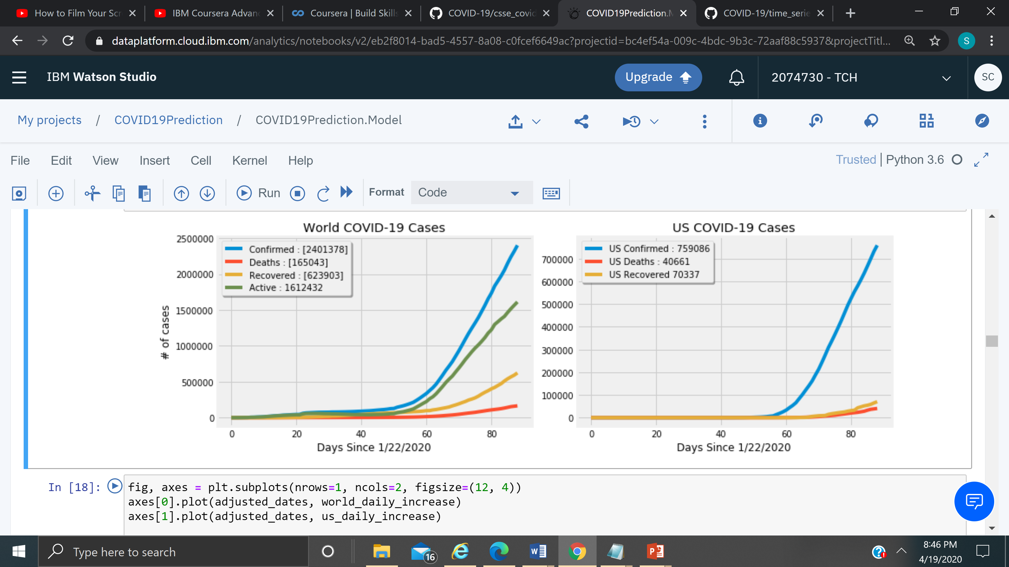
COVID-19 Predictions : Cases by World, US

Slide 11
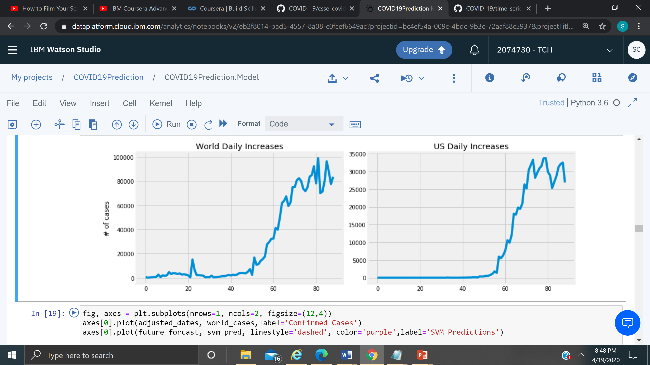
COVID-19 Predictions : Daily Increase in Cases

Slide 12
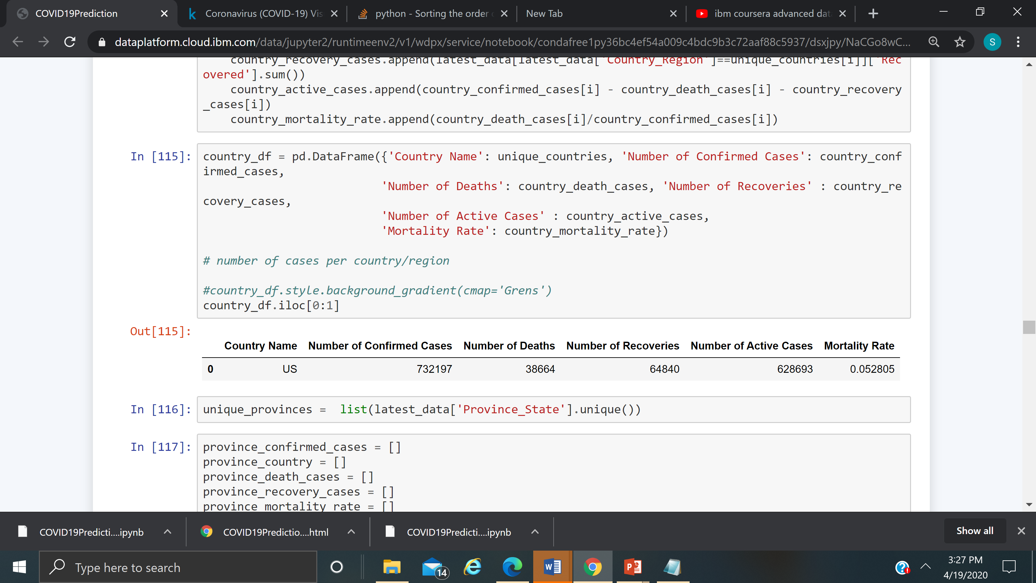
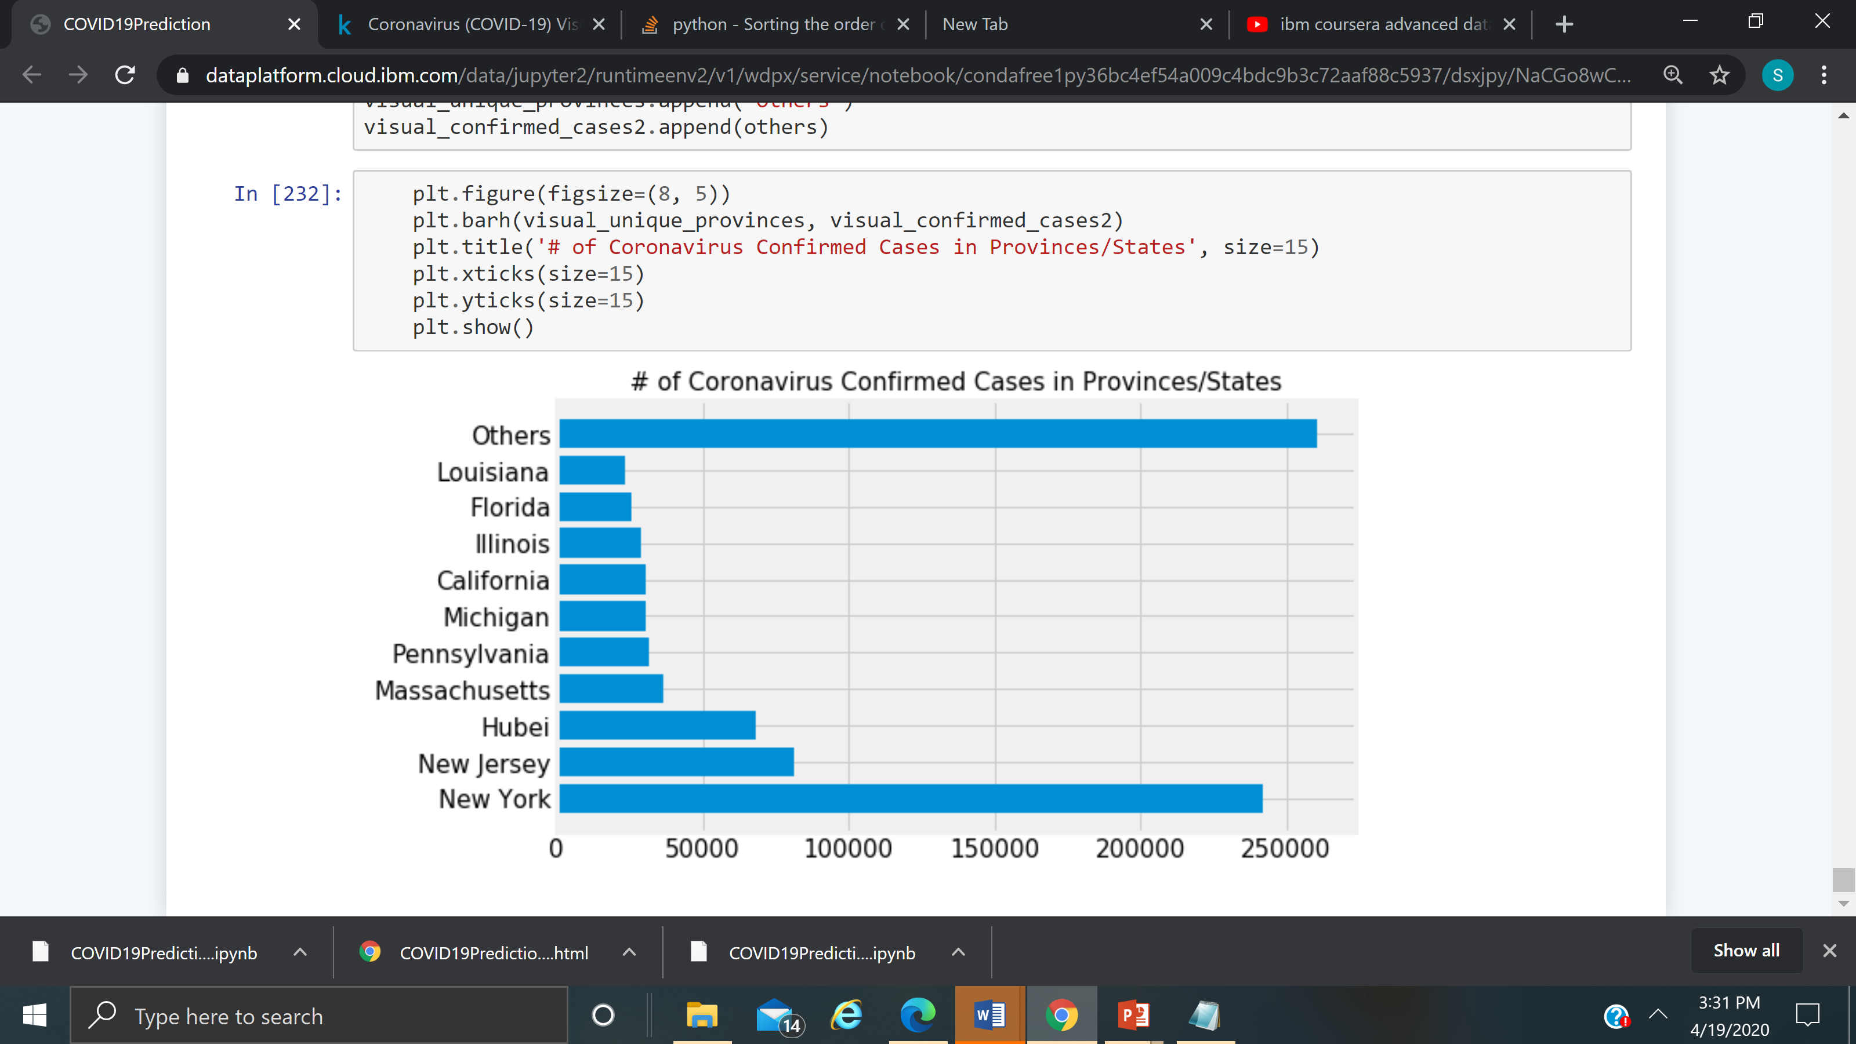
COVID-19 Predictions : US cases in the top

Slide 13
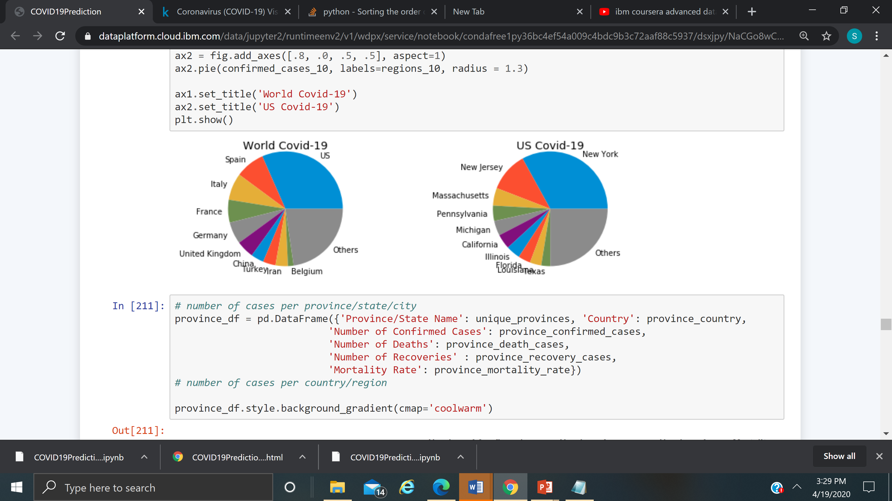
COVID-19 Predictions : Chart by top 10 World, US

Slide 14
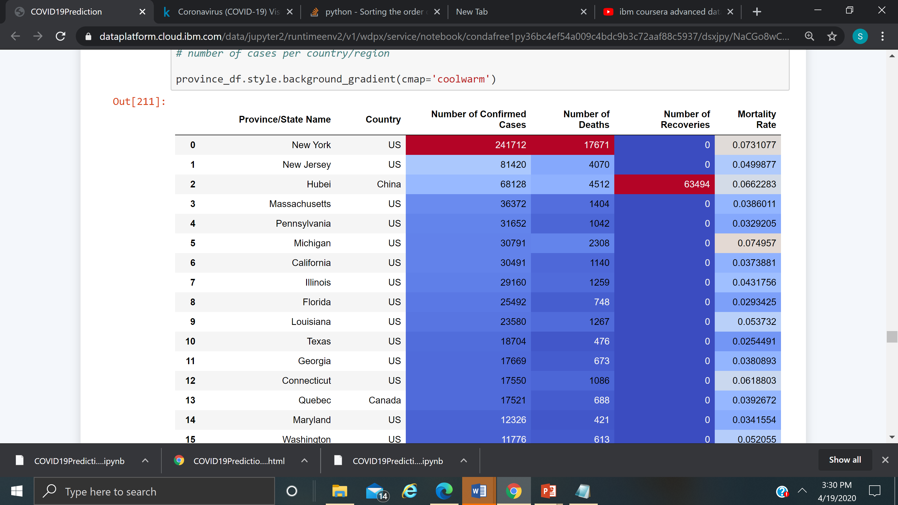
COVID-19 Predictions : Data by Province/State

Slide 15
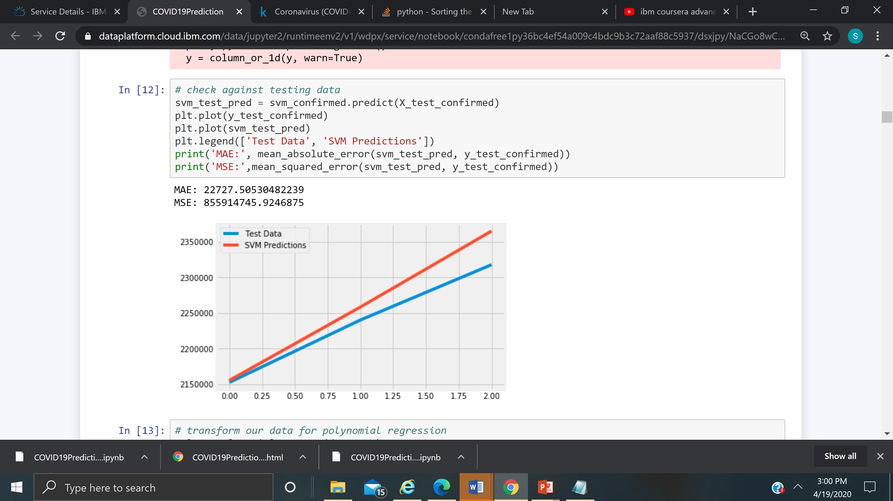
COVID-19 Predictions : SVM In machine learning, support-vector machines are supervised learning models with associated learning algorithms that analyze data used for classification and regression analysis.

Slide 16
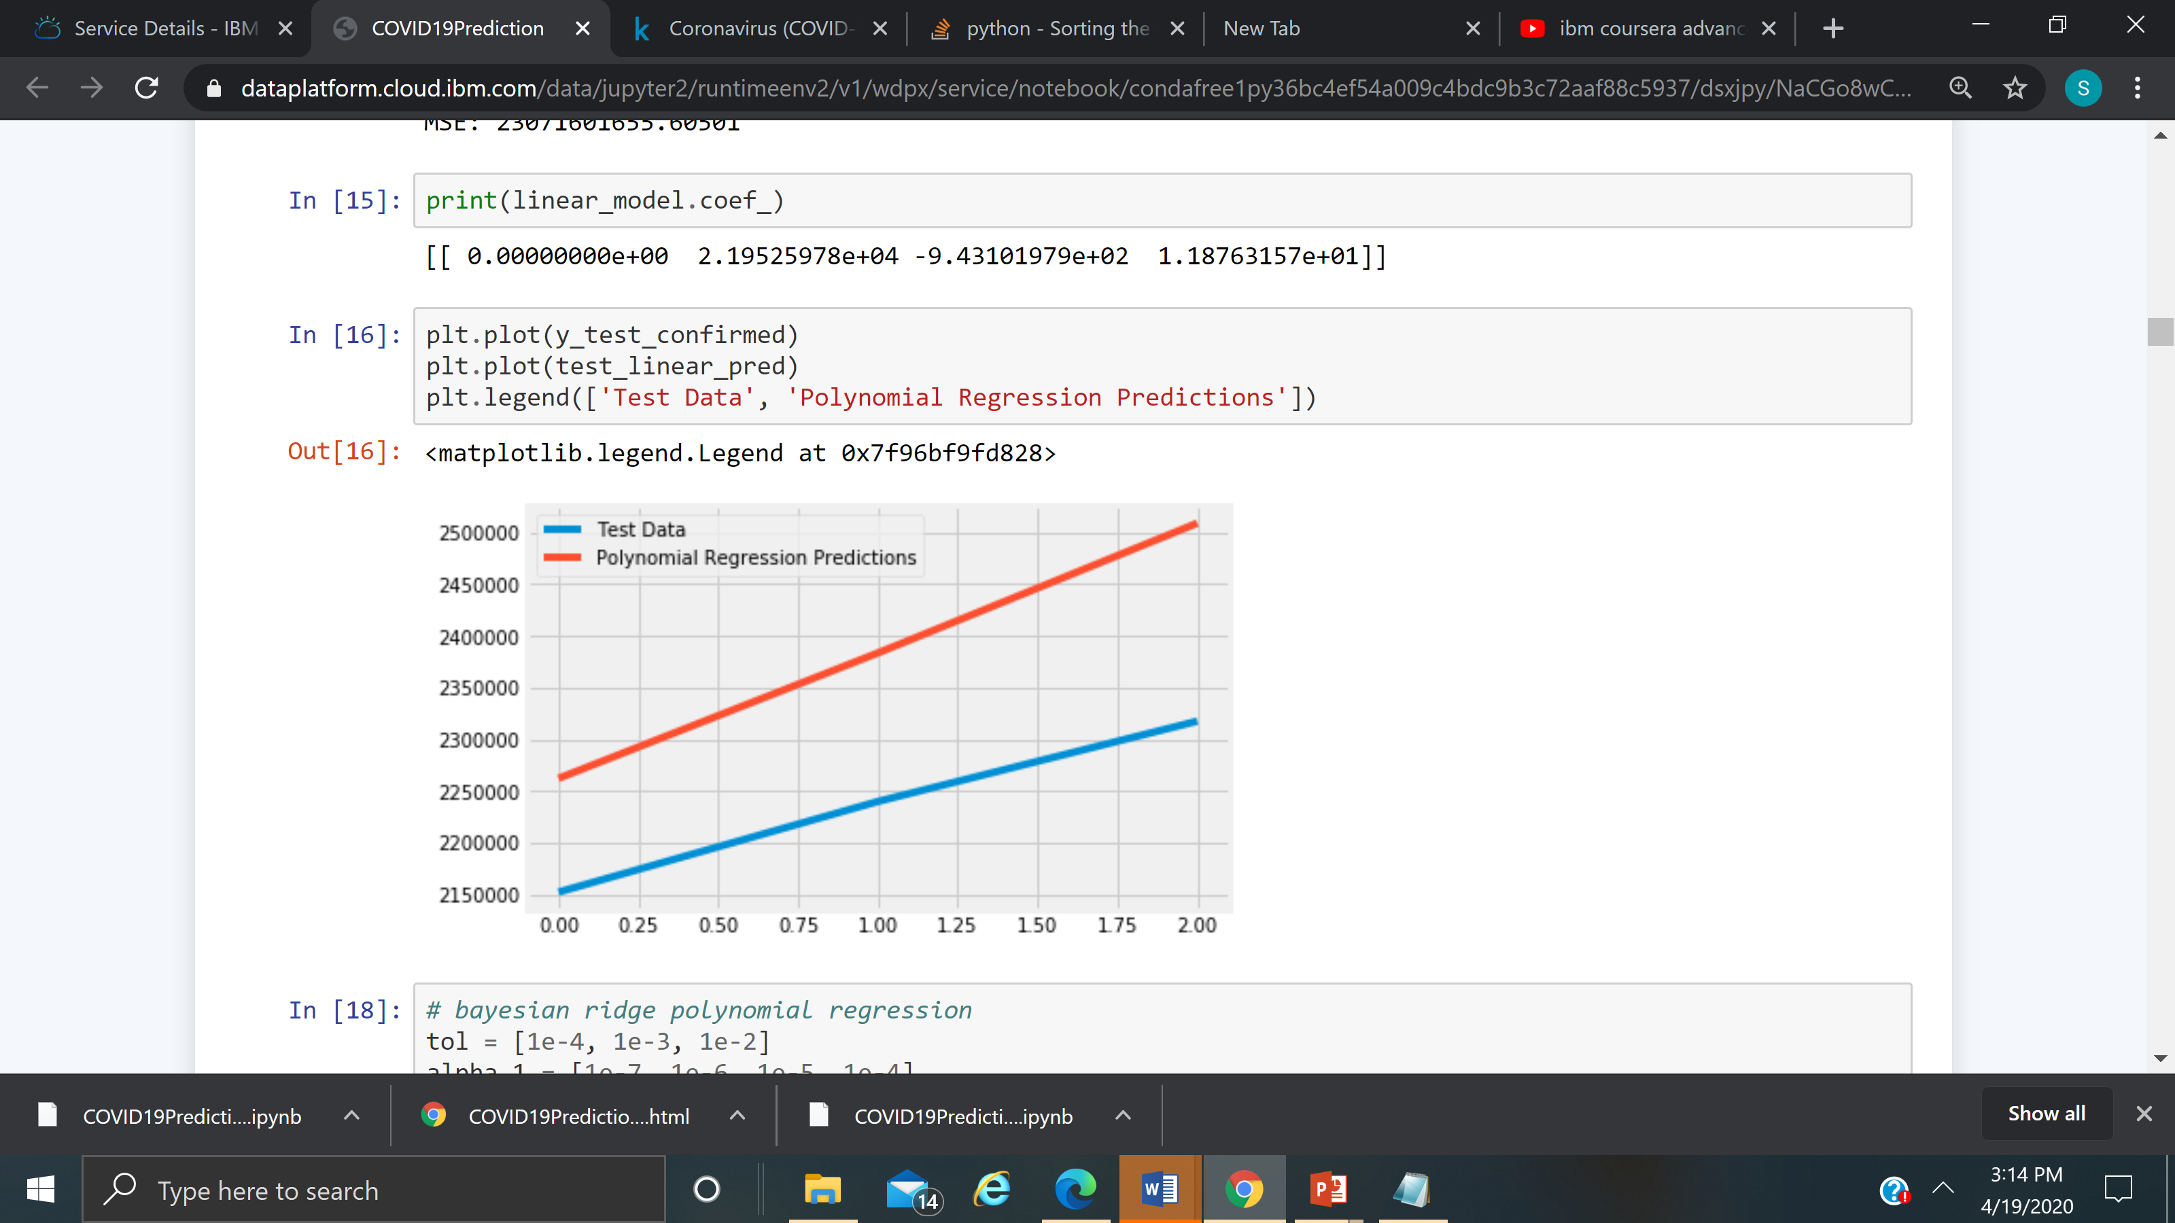
COVID-19 Predictions : Polynomial Regression original features are converted into Polynomial features of required degree (2,3,..,n) and then modeled using a linear model."
MAE: 148174.50781263752 MSE: 23071601655.60501
MAE: 148174.50781263752
MSE: 23071601655.60501

Slide 17
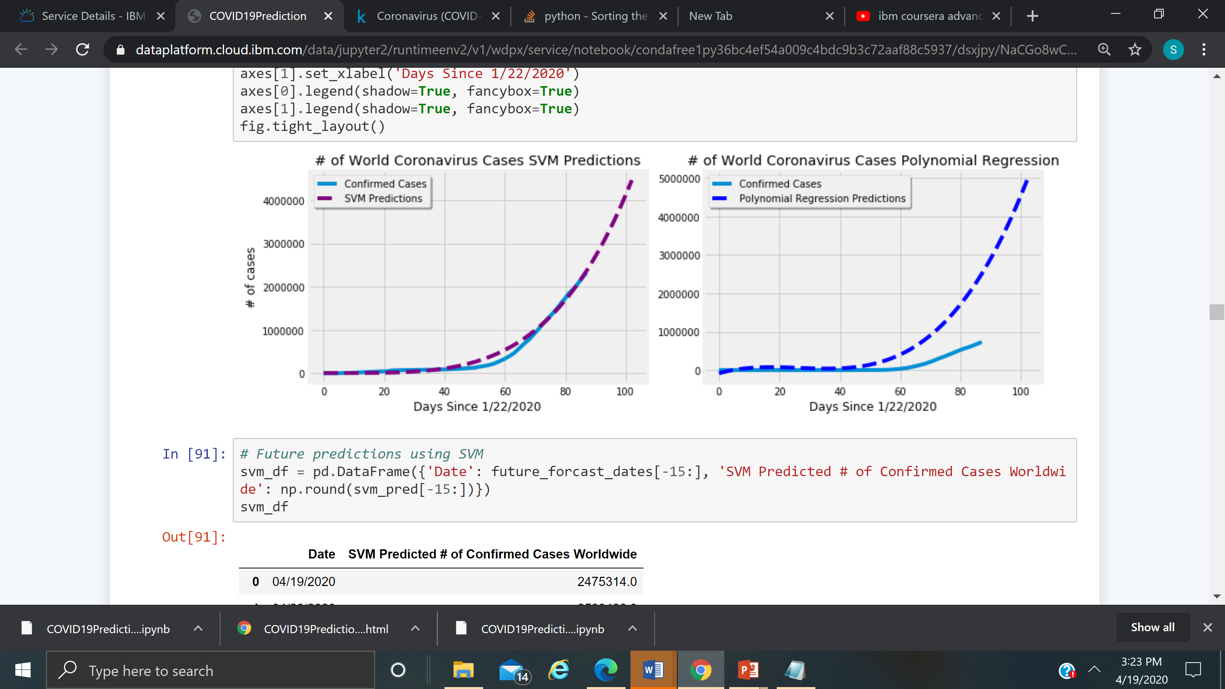
COVID-19 Predictions : Confirmed cases vs SVM or Polynomial Regression

Slide 18
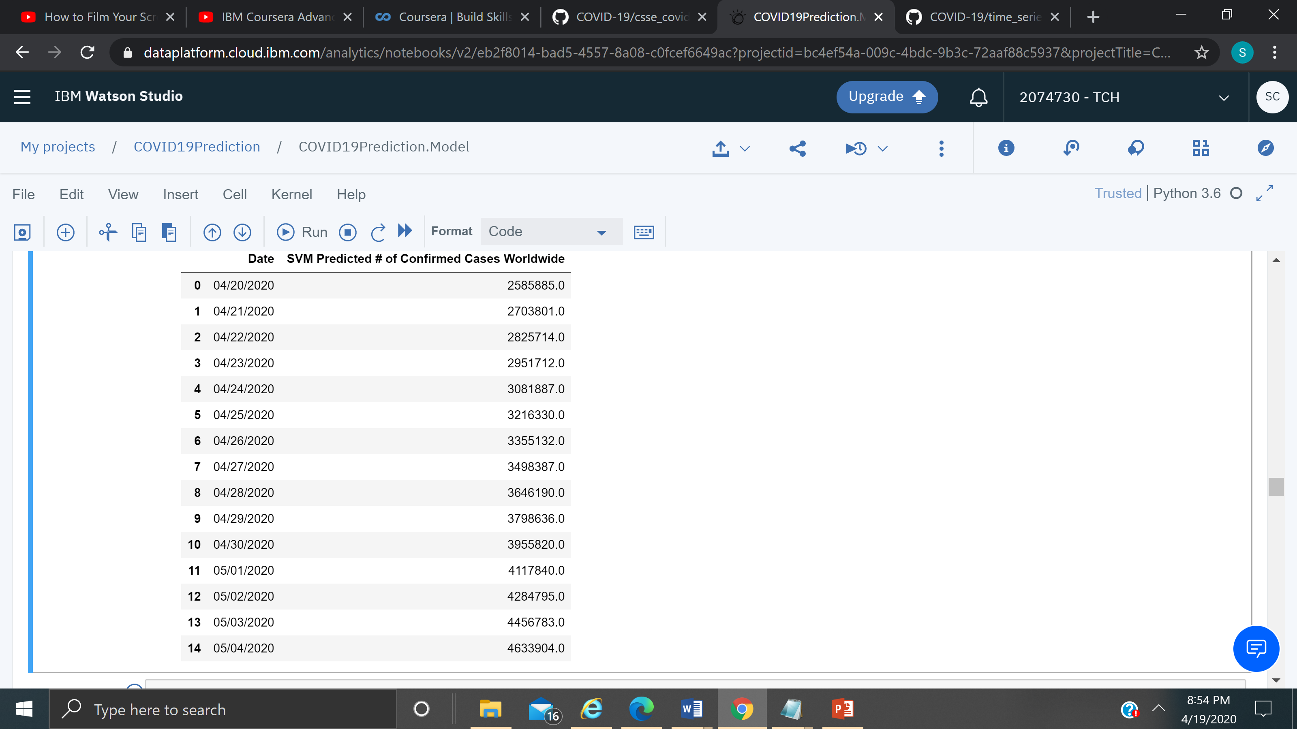
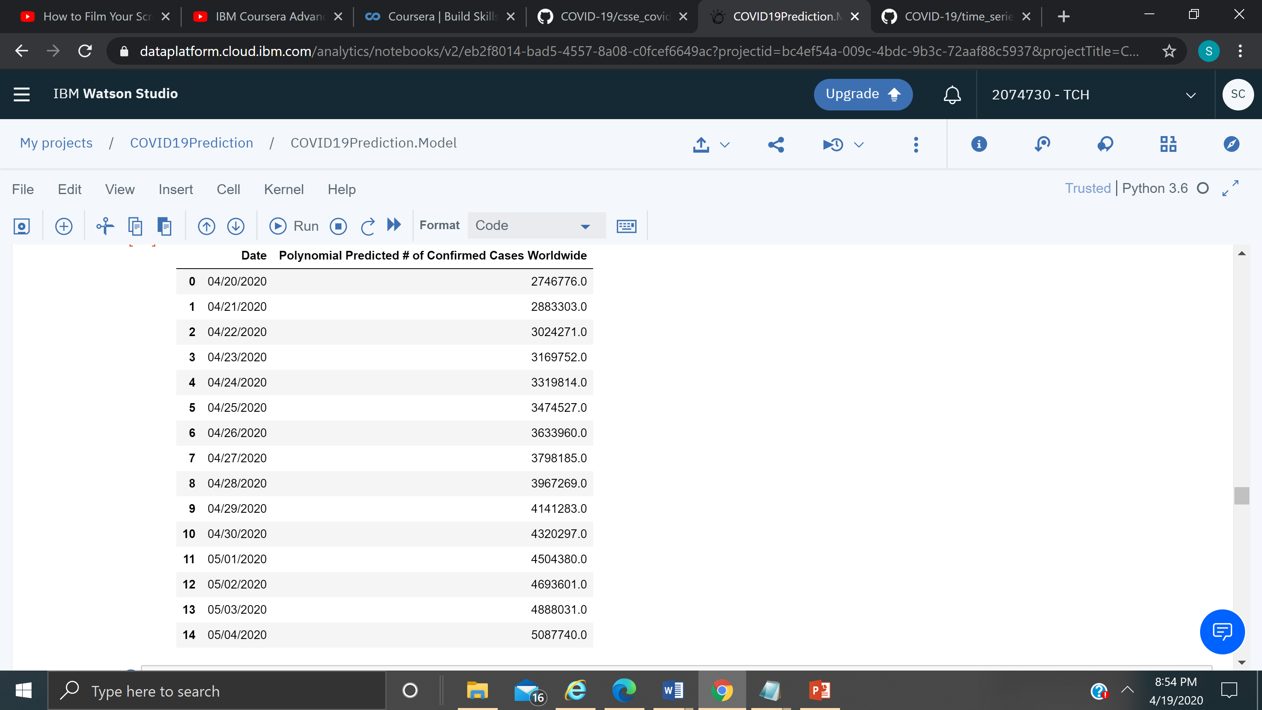
COVID-19 Predictions : SVM vs Polynomial by day

Slide 19
Prevention : Protect yourself and others around you by knowing the facts and taking appropriate precautions. Follow advice provided by your local public health agency.
Protect yourself and others around you by knowing the facts and taking appropriate precautions. Follow advice provided by your local public health agency.
To prevent the spread of COVID-19:
Clean your hands often. Use soap and water, or an alcohol-based hand rub.
Maintain a safe distance from anyone who is coughing or sneezing.
Don’t touch your eyes, nose or mouth. Use Gloves and Masks when you are going out.
Cover your nose and mouth with your bent elbow or a tissue when you cough or sneeze.
Stay home if you feel unwell.
If you have a fever, a cough, and difficulty breathing, seek medical attention. Call in advance.
Follow the directions of your local health authority.
Avoiding unneeded visits to medical facilities allows healthcare systems to operate more effectively, therefore protecting you and others.

Slide 20
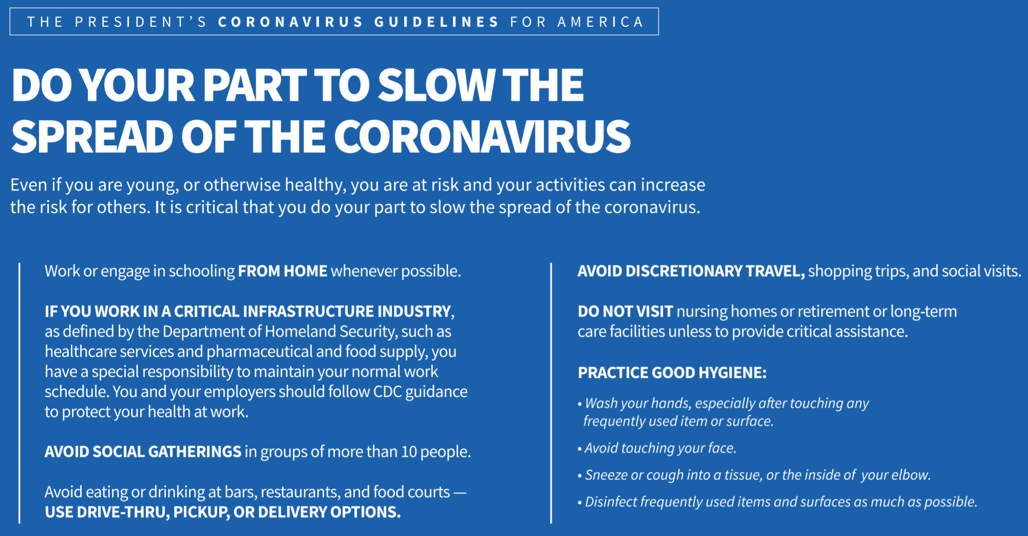

Slide 21
Reference
Github files can be accessed at the below path
https://github.com/sreelakshmiTCH/IBM_Data_Science_Coursera_Capstone

Slide 22
Acknowledgements
I would like to say Thanks to
Johns Hopkins University for the dataset,
Github for the having COVID-19 time series repository files
Kaggle for referring to the dataset Github files and some of the code
IBM for Providing an opportunity to work on the Capstone Project using IBM Watson Studio.
my instructor Romeo Kienzler for teaching Coursera classes on IBM Advanced Machine Learning.
my Stakeholders and Peers for reviwing.

